Slide 1
Reigniting your donation outreach…
…in today’s changed world

Slide 2
Strategies for Nonprofit Success
WELCOME

Slide 3
Special thanks to our sponsor…

Slide 4
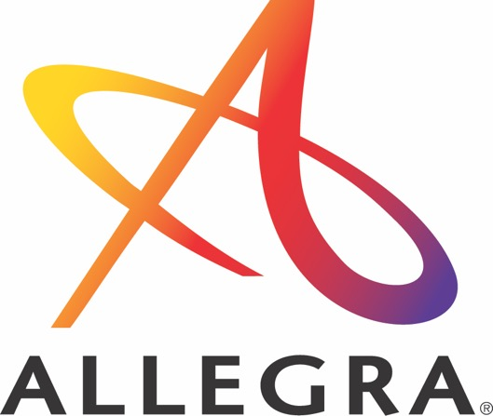
Introduction…
Reigniting your donation outreach in today’s changed world

Slide 5
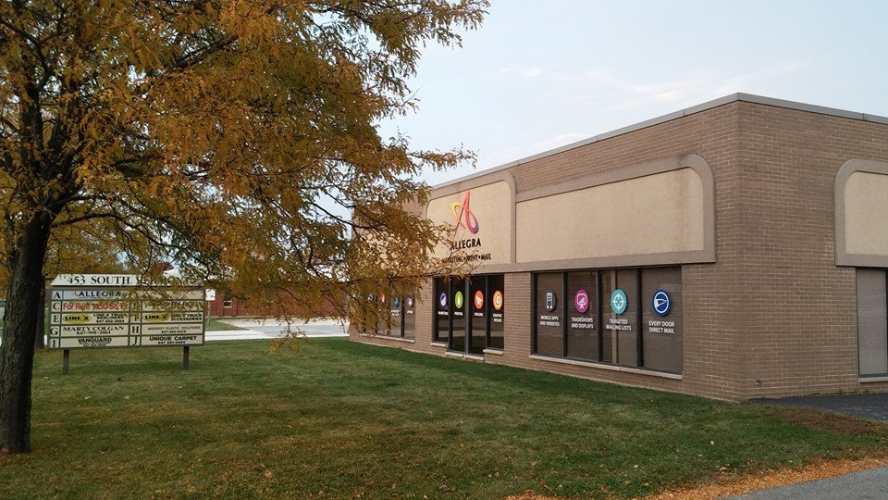
About Me
Notes:
Business – 22 years
OLD enough to drink
A lot has changed in 22 years
Started out life as Insty-Prints

Slide 6
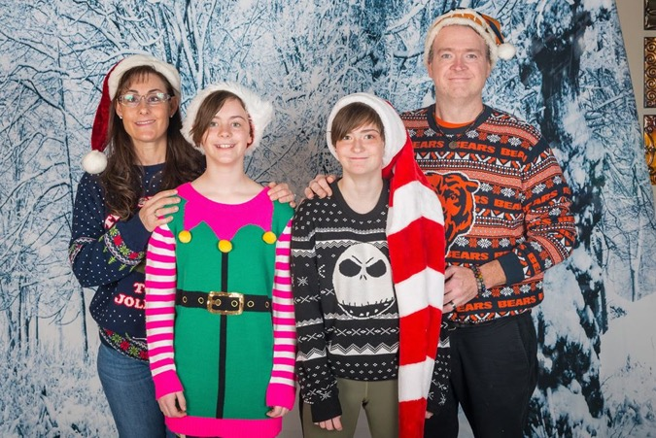
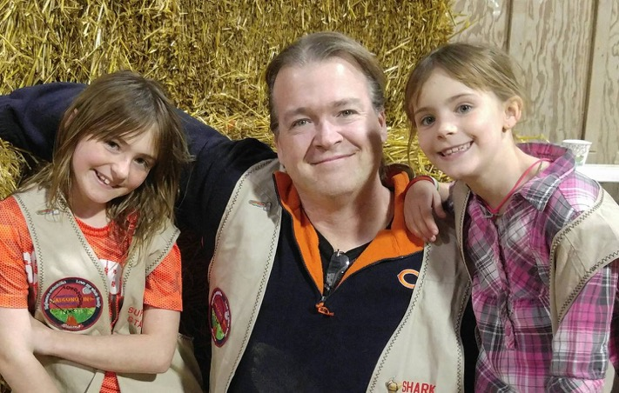
About Me
Notes:
Family is the most important thing to ME
You’ll understand why I show you this in a moment

Slide 7
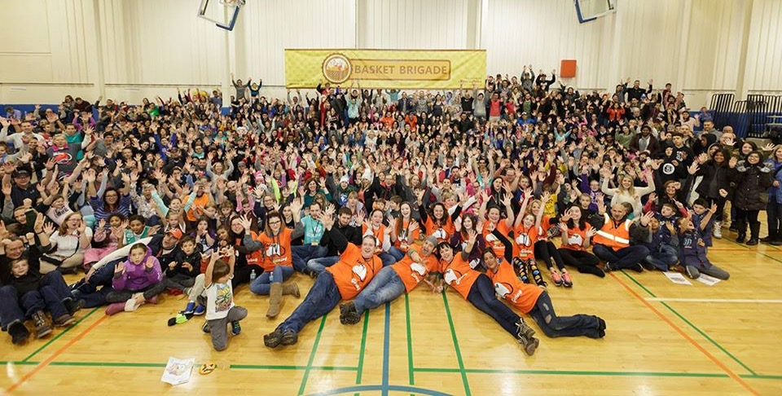
About Me

Slide 8
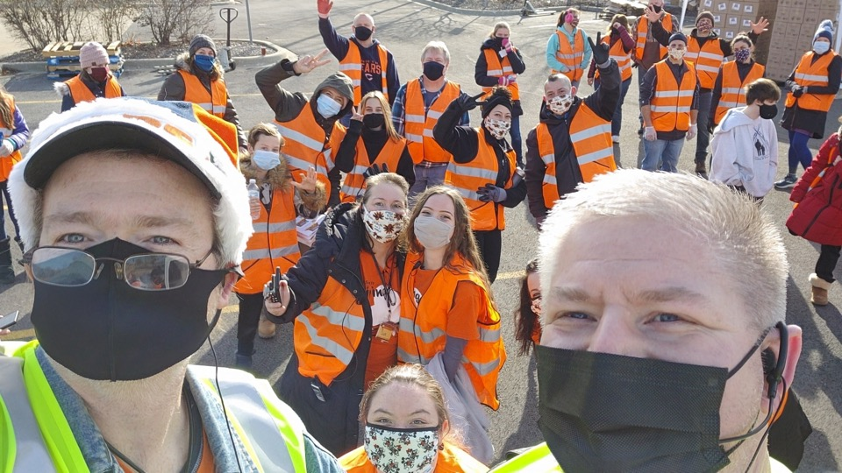
And this was me during 2020…
…the year that changed EVERYTHING

Slide 9
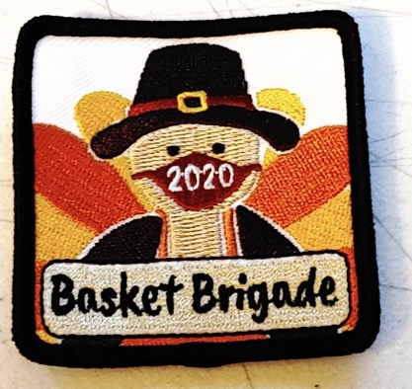
2020 Questions
Would People continue to give?
Would Corporations continue to give?
If so, at what levels?
How will this impact volunteerism?
How will this impact the need of those we serve?
When will we know?
How will local laws impact us?
How can we handle in-person events?
…and likely many more

Slide 10
What to did nonprofits do?

Slide 11
Americans spending less overall but budgeting more for two areas: child-care and charities.
Nearly 75% doing something nice or patronizing neighborhood businesses forced to close, decrease capacity or didn’t receive government funds
Top acts of kindness:
More generous tipping (42%)
Paying extra for services/back paying for unused services like haircuts and gym membership dues (11%).

Slide 12
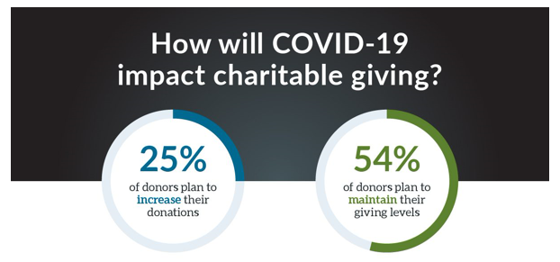

Slide 13
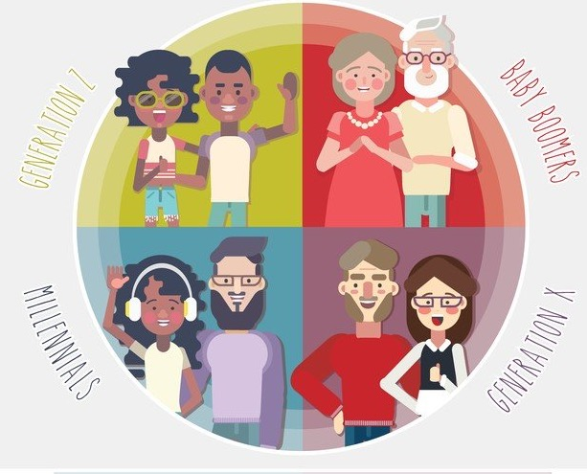
Who’s Spending?
Younger generations step up!
46% of Millennials will give more in response to pandemic
25% of Gen X
14% of Baby Boomers

Slide 14
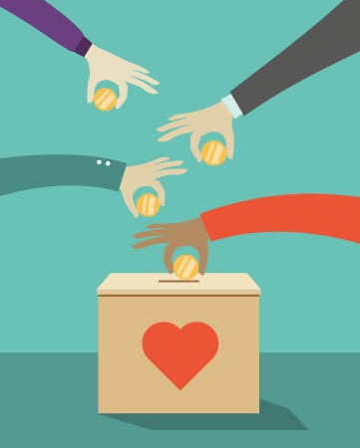
Most Donors Staying the Course
43% will continue to donate to the non-profits they supported before, as COVID has likely impacted all organizations
25% will shift part or all their donations to organizations responding to COVID-19.

Slide 15
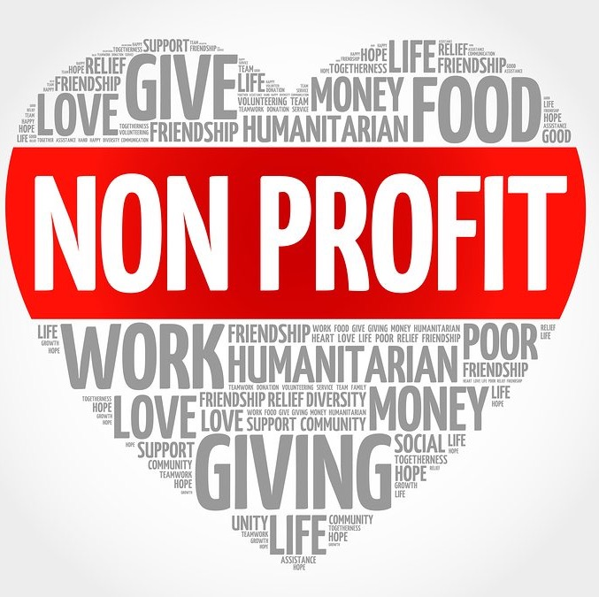
What Donors Are Concerned About
Roughly 80% of donors concerned about ability of health and human related non-profits to deliver services
But at least half also concerned about organizations working in other areas, like the arts and environment.

Slide 16
Volunteer Challenges
Volunteer activity is likely to dramatically decrease due to the pandemic.
Stay at home orders creating challenges to deliver critical services.
47% of volunteers believe their time will decrease or stop
57% of Boomer donors will decrease volunteering
Silver Lining: 9% of Gen X and 31% of Millennials expect their volunteer time to increase.
https://money.yahoo.com/heres-where-americans-plan-to-spend-more-as-economy-reopens-180045525.html?soc_src=community&soc_trk=ma
https://www.fidelitycharitable.org/insights/how-covid-19-is-shifting-donor-giving.html

Slide 17
Non-profit Challenges Today
Engagement with donors is different
Events can’t take place the way they used to
Ability to provide in-person services are affected
Donors need new, easier ways to support the cause
Businesses aren’t fully operating hurting available funds for donation
Faith-based giving is affected with lack of church services in-person

Slide 18
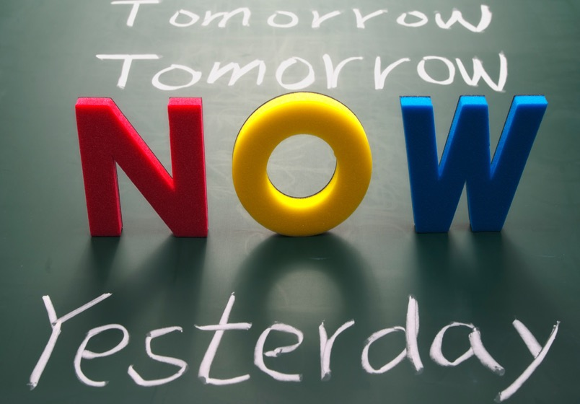
Timing: Act NOW
Giving is still happening!
In some types of organizations, services are needed now more than ever
Don’t give up on those who did not donate in 2020
Non-profits will still need to be creative in lieu of in-person events

Slide 19
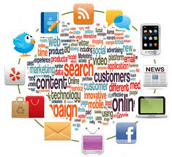
CHALLENGES TODAY
Average person is exposed to 1.85 million messages per year
Average number of advertisement and brand exposures per day per person: 5,000+
Average number of “ads only” that we have some awareness of per day: 86
Average number of “ads only” that made an impression (engagement): 12
Source: sjinsights.net, 2014

Slide 20
Summary
It Takes 7 to 22
Touchpoints to Convert.
DMA, 2018
People are still donating! Keep engaging and raising awareness of your cause.
Look for new ways to communicate and adapt to our “new world”
Make donating to your cause EASY with a great website
Use data to personalize
Multi-channel, multi-touchpoint is key!

Slide 21
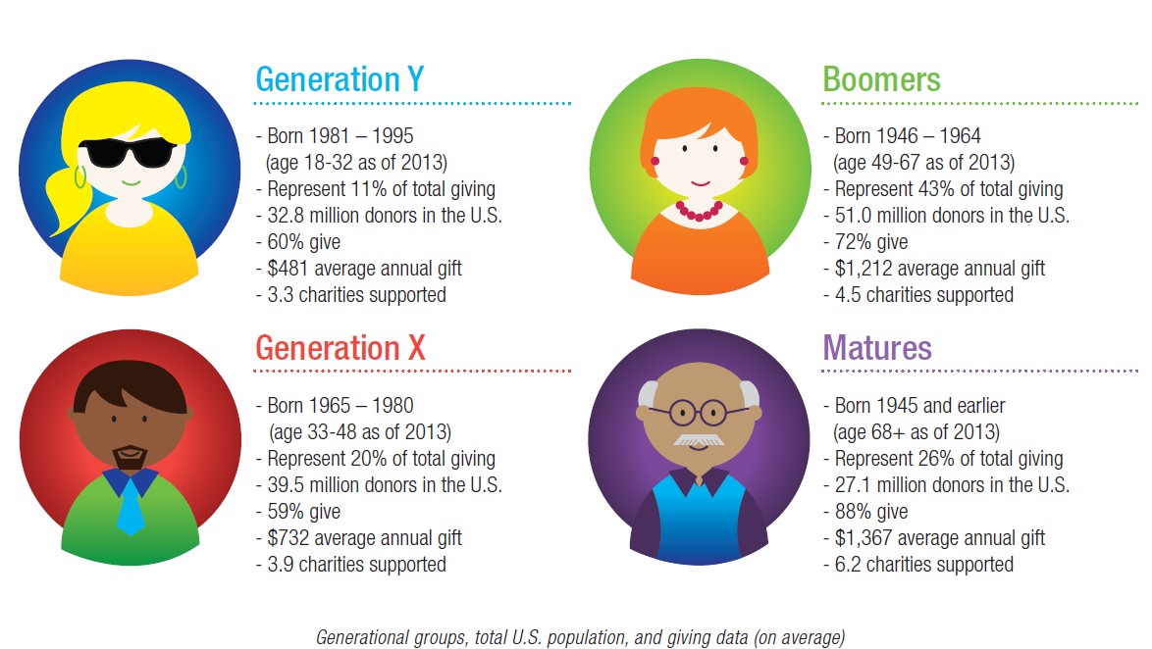
CHALLENGES TODAY
Donors across ALL Generations are Multi-Channel
Source: Next Generation of American Giving, Blackbaud, 2013

Slide 22
Expanding your reach; who to target?

Slide 23
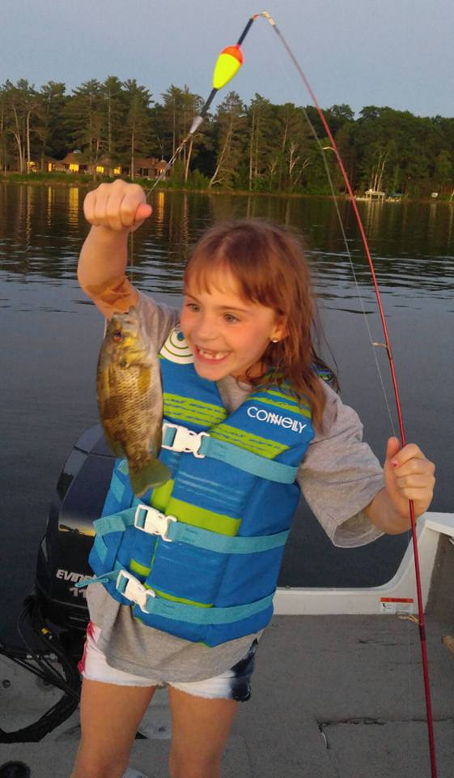
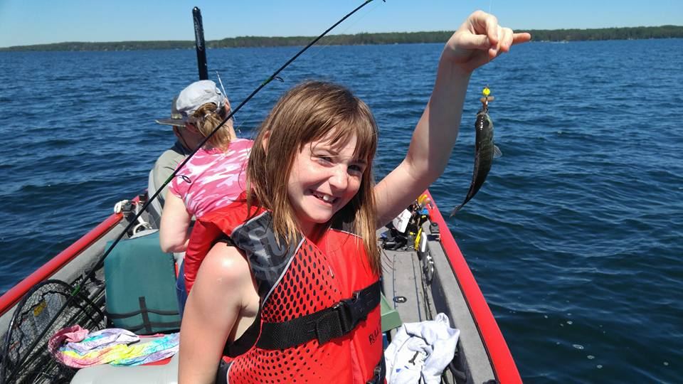
Fish where the fish are…

Slide 24
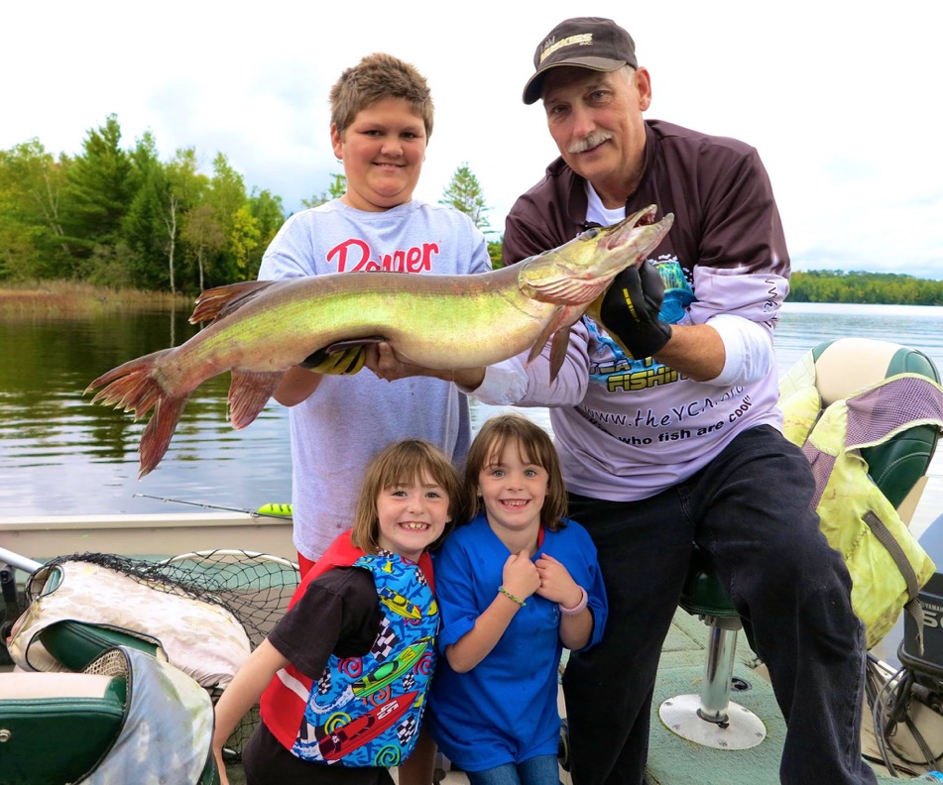
Fish where the fish are…

Slide 25
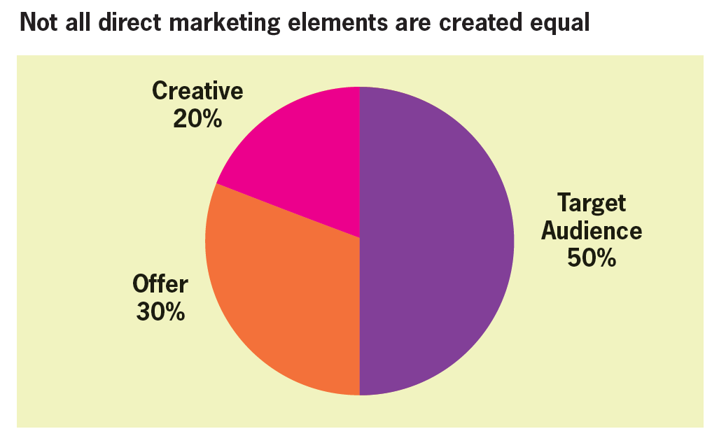
LIST

Slide 26
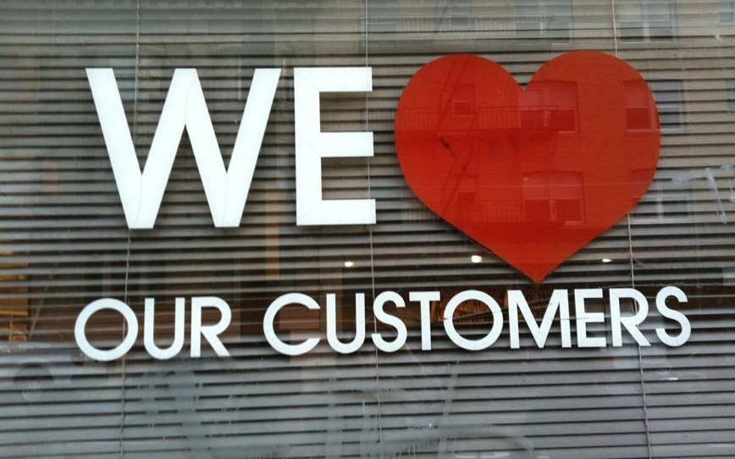
Nothing Beats Your House List
Your existing donors already know and love you…
Frequent Communication is Okay
Focus on Value
Strategic Offers
Strategic Upselling
Ask for Referrals
Share your news

Slide 27
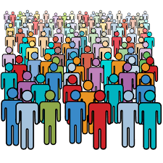
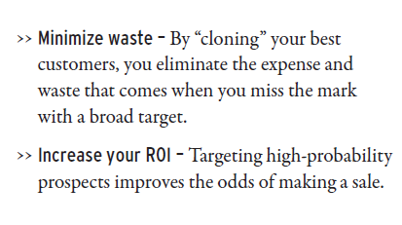
Profile & Clone Your Existing Donors

Slide 28
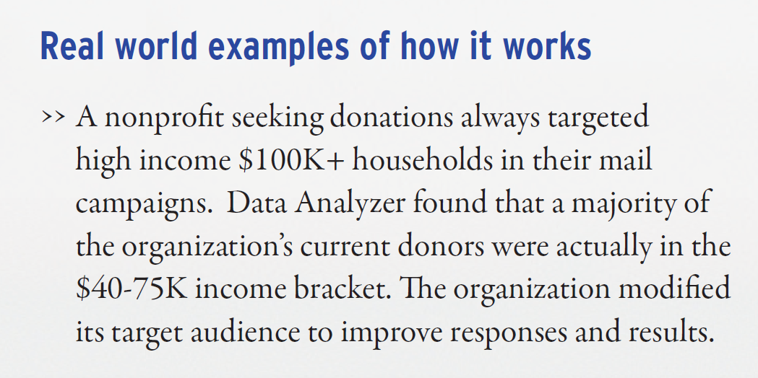
Be sure your assumptions are correct

Slide 29
Get highly targeted
There are millions of databases with various selects, so your marketing can be more targeted that ever:
2,066 charitable donor lists available
Highly-specific consumer lists
More target lists =
less waste + better response!

Slide 30
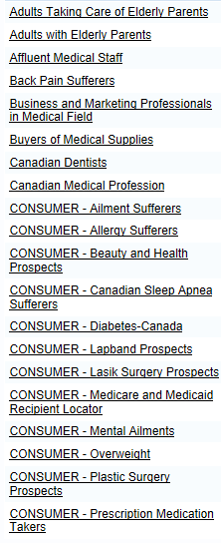
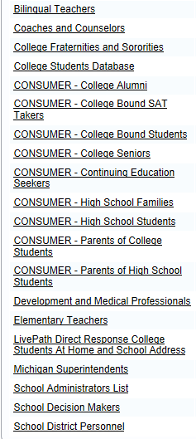
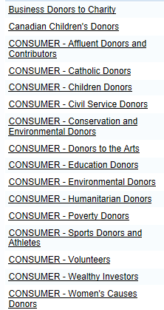
Get the Best, Targeted List

Slide 31
How to reach them in the changed world

Slide 32
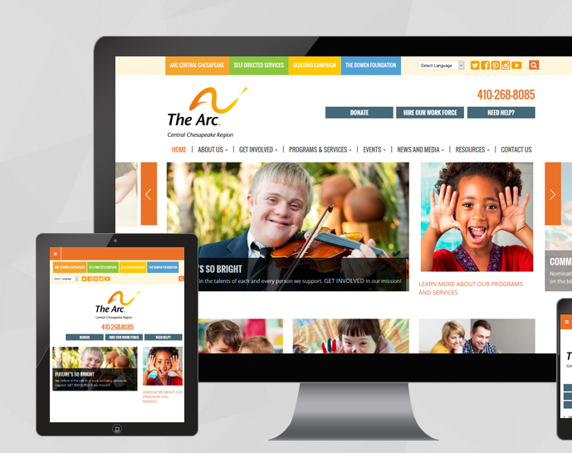
Website Critical to the Journey
Non-profits ranked websites as #1 communication channel.
Less than half of non-profit websites are responsive.
Responsive donation pages yield 34% more gifts than non-responsive pages.
Sources: Nonprofit Hub, Mobile Cause

Slide 33
ONLINE GIVING
The Internet has become a significant source of giving and of new donor acquisition.

Slide 34
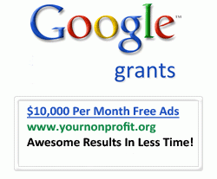
Your Online Presence

Slide 35
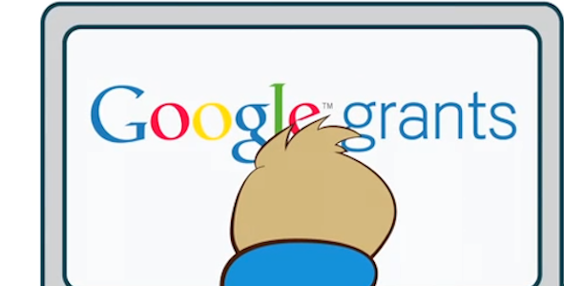
Your Online Presence
Google Grants
When you qualify for Google Ad Grants, you will have access to a AdWords budget of $10,000 per month (about $329 per day). These funds can be used only on keyword search campaigns with text ads only – No display advertising or product ads and no appearing on search partner pages. Additionally, the limit for cost-per-click is set at $2, so you might need to get creative with your keywords if you want these ads to run for highly competitive terms.

Slide 36
Social Media
Social Media in no longer optional
92% of nonprofits indicate that social media is important for their business
www.socialmediaexaminer.com/SocialMediaMarketingIndustryReport2014.pdf

Slide 37
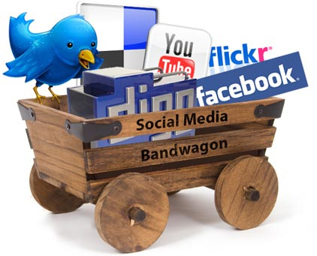
Social Media
Pick your platform(s)
Post often
Don’t “sell”
Share-worthy content
Respond to questions
Be the expert

Slide 39
So Many Channels to Choose
Over 120 Channels to Manage
Must Choose and Prioritize!

Slide 40
Email Marketing
Getting the Word Out
Permission-based email strengthens current customer relationships and helps create new ones.
Email marketing is the low-cost way to supplement sales, advertising, traditional mail and other activities to stay in front of prospects and customers.

Slide 41
Each month, we watch over 6 billion hours of video on YouTube, and upload 100 hours of video every minute
40% of all online video is viewed on a mobile device
Consumers are 27x more likely to click through online video ads than standard banners (Source: Sizmek)
After 72 hours, a person retains about 10% of the text they’ve read, 65% of an image they’ve seen or 95% of a video they’ve watched

Slide 42
VIDEO VIEWING STATS
According to comScore’s online engagement statistics:
90% of online shoppers at one retailer’s site said videos helped them decide to purchase ¹
57% of consumers said video made them more confident of their purchases*
Forbes says:
75% of executives watch at least one biz video a week ²
65% of those execs visited the company’s website after viewing the video ²
1 .comScore online engagement study, 2011 2. Douglas Kerr, Marketing TechBlog, 2013
*http://www.invodo.com/resources/statistics/
2. images.forbes.com/forbesinsights/StudyPDFs/Video_in_the_CSuite.pdf

Slide 43
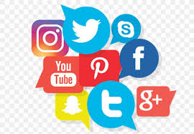
Share Your Story on Digital
A Different Look…
Social media
Website retargeting/banner ads
Create/share videos
Staying home can lead to an almost 60% increase in the amount of content people watch.
32% of respondents are spending longer on social media.
80% watching more video-based content (broadcast TV, online videos, etc.).
https://noblestudios.com/how-have-digital-consumption-habits-shifted-during-the-covid-19-pandemic/

